Slide 1

Ramakrishna Mission Polytechnic College
Department of Computer Engineering
Li-Fi
Name of the Students | Department | Register Number
MUTHYALAPATI SIVAKRISHNA | Ⅲ-DCE | 24509639
MOTHILAL PRABU .RD | Ⅲ-DCE | 24509636

Slide 2

Li-Fi Technology
Light Fidelity Comprehensive Presentation
A deep dive into wireless communication using light: Working principles, architecture, advantages, limitations, and real-world applications
August 7, 2025
Made with Genspark

Slide 3
Table of Contents
1
Introduction to Li-Fi
Working Principles
How Li-Fi Works (Technical Details) System Architecture & Components Advantages of Li-Fi
2
3
4
5
6
Disadvantages & Limitations
Li-Fi vs Wi-Fi Comparison
Data Transmission: Wi-Fi vs Li-Fi
Applications & Use Cases
Current Deployments & Companies
Future Outlook & Conclusion
Light as the medium for
next-generation wireless communication
7
8
9
10
11
Page 2

Slide 4

Introduction to Li-Fi
Definition: Li-Fi (Light Fidelity) is a wireless communication
technology that uses light-emitting diodes (LEDs) to transmit data through visible light spectrum.
Origin: First introduced by Professor Harald Haas during a TED Global talk in 2011.
Core Technology: Based on Visible Light Communication (VLC)
system, using rapid modulation of LED light intensity to transmit data.
Motivation: Addresses limitations of RF-based wireless systems, offering higher speeds, security, and usage in RF-restricted
environments.
Current Status: Rapidly evolving from experimental technology to commercial solutions with speeds reaching up to 224 Gbps in
laboratory settings.
"Illumination with Communication" - Harald Haas
Using the same LED lights that illuminate our spaces to transmit data
Page 3

Slide 5
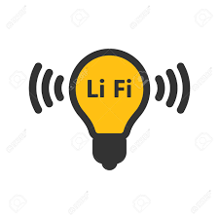
Working Principles of Li-Fi
Visible Light Communication (VLC): Li-Fi uses the visible light
spectrum (400-800 THz) as a medium for data transmission instead of radio waves.
Modulation Technique: Data is transmitted by modulating the
intensity of LED light at extremely high speeds (imperceptible to the human eye).
Binary Transmission: LED light sources rapidly switch ON and OFF to represent binary data (1's and 0's) at frequencies of millions of times per second.
Photodetection: A photodiode at the receiver end detects these
subtle light variations and converts them back into electrical signals.
Signal Processing: The electrical signals are then processed and converted into a data stream that devices can interpret.
Key Insight: Human Eye Perception Limit
LEDs can be switched on and off at speeds undetectable by the human eye (>100 MHz), allowing for seamless illumination and data transmission simultaneously.
Page 4

Slide 6
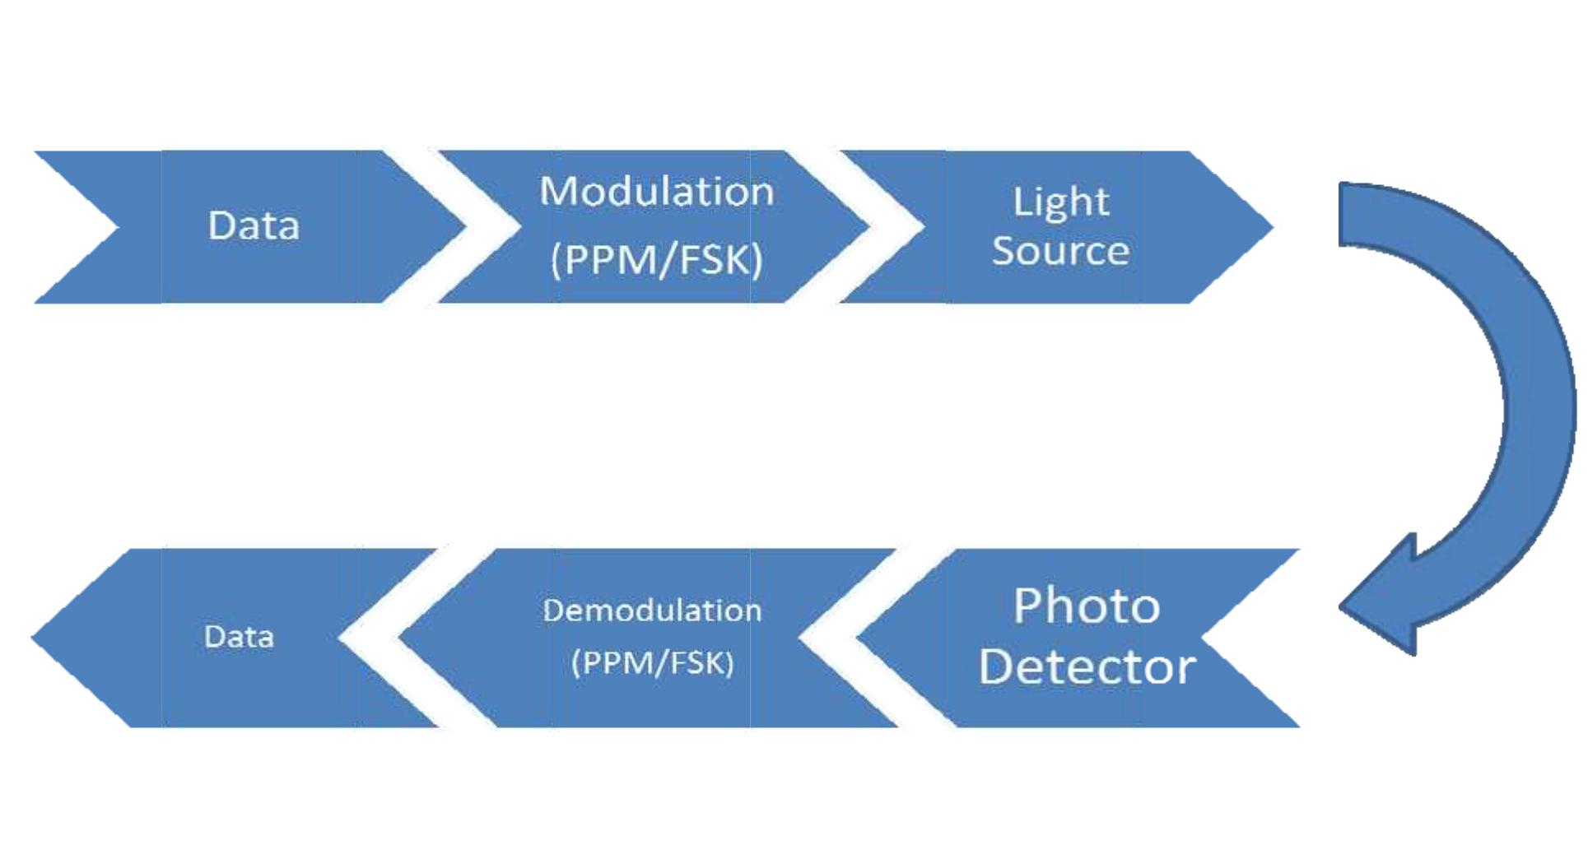

How Li-Fi Works: Technical Details
Data Encoding: Digital data (0s and 1s) is encoded and fed to LED driver circuits.
LED Modulation: LEDs are switched on/off at extremely high
speeds (millions of times per second) - "on" represents binary 1, "off" represents binary 0.
Light Transmission: Modulated light signals travel through space at ~300 million meters/second.
4 Photodetection: Photodiode on receiving device detects light intensity variations and converts them to electrical signals.
Key Technical Requirements
Line-of-sight between transmitter and receiver
Photodetectors with adequate sensitivity and response time
LED drivers capable of high-frequency switching (MHz-GHz range) Signal processing capabilities to handle ambient light interference
5 Signal Processing: Amplification, demodulation, and decoding converts signals back into usable binary data.

Slide 7
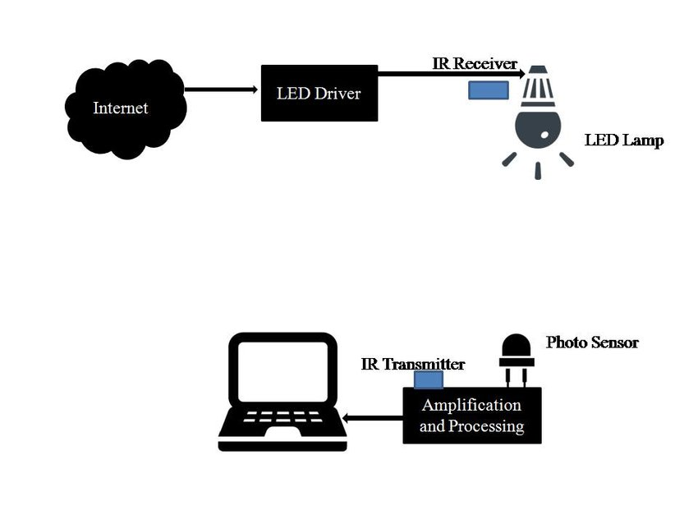



System Architecture & Components
Key Components:
LED Light Source & Modulator
Modulates intensity of light at high speeds to transmit data. Acts as the transmitter in the Li-Fi system.
Photodiode Receiver
Detects variations in light intensity and converts them into electrical signals that can be processed as data.
Signal Processing Unit
Processes the electrical signals, applies error correction, and converts data into usable format.
System Operation Flow
Data from internet arrives at Li-Fi router/access point
LED driver modulates light at ultra-high frequencies
Photodetector in receiving device captures light signals
Amplifier and processor convert signals to usable data
Data Access Point
Connects the Li-Fi system to the internet backbone, enabling bidirectional data flow.
Page 6

Slide 8
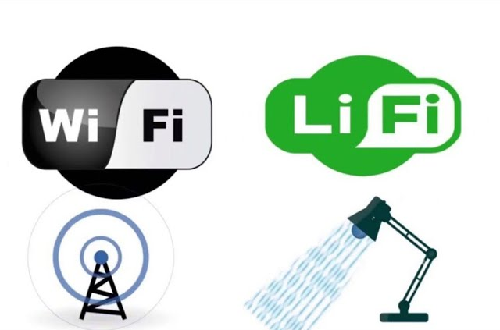
Data Transmission: Wi-Fi vs Li-Fi
Wi-Fi (Radio Waves):
Device data → Router converts to radio waves using antenna.
Radio waves travel through air → Received by another antenna.
Receiver demodulates radio signals back into binary data.
Li-Fi (Light Waves):
Device data → LED light intensity modulated (ON = 1, OFF = 0).
Light waves travel → Photodiode detects flickers.
Receiver demodulates light into binary data → Original information restored.
👉 Both use modulation & demodulation, but one uses RF (GHz) and the other Visible Light (THz).
Page 6

Slide 9



Advantages of Li-Fi
Ultra-Fast Speeds: Up to 224 Gbps in laboratory settings, far exceeding current WiFi capabilities
Enhanced Security: Light cannot penetrate walls, containing data within physical spaces and preventing external interception
No Electromagnetic Interference: Operates outside the radio spectrum, preventing interference with sensitive equipment
Energy Efficiency: LED lights consume less power than conventional lighting while simultaneously transmitting data
Unlimited Bandwidth Potential
Visible light spectrum is 10,000 times larger than the entire radio frequency spectrum
Safe in RF-Sensitive Environments
Ideal for hospitals, aircraft, nuclear plants where radio waves may cause interference
Higher Data Density
Functions well in dense environments with multiple users without performance degradation
Underwater Communication
Unlike radio waves, light can penetrate water, enabling underwater data transmission
Page 7
"In a world increasingly connected, Li-Fi offers speed, security and sustainability."

Slide 10
Disadvantages & Limitations of Li-Fi
Line-of-Sight Requirement: Li-Fi requires direct line-of-sight between transmitter and receiver for optimal performance
Physical Barriers: Light cannot pass through walls or opaque objects, limiting connectivity to a single room
Illumination Dependency: Internet access only available where light source is present; lights must remain on for connectivity
Infrastructure Costs: Requires new infrastructure implementation for widespread adoption
Interference Issues: Susceptible to interference from ambient light sources including sunlight
Range Limitations: Coverage area typically limited to 10-20 meters (compared to Wi- Fi's ~30 meters)
Limited Mobility
Challenges for mobile devices as continuous connection requires staying within light coverage area
Integration Challenges
Requires integration with existing lighting systems and modification of device hardware
Limited Standardization
IEEE 802.11bb standards still in development; lack of universal implementation protocols
While Li-Fi offers significant advantages, these limitations must be addressed for mainstream adoption
Page 8

Slide 11

Li-Fi vs Wi-Fi: Comparison
Feature | Li-Fi | Wi-Fi
Transmission Medium | Light waves (Visible light spectrum) | Radio waves (RF spectrum)
Speed | Up to 224 Gbps (lab conditions) | Up to 10 Gbps (Wi-Fi 6/6E)
Coverage | 10-20 meters (limited by light) | 30-100 meters (depending on obstacles)
Security | Very high (contained within room) | Moderate (can penetrate walls)
Interference | Minimal (not affected by RF) | High (from other RF devices)
Bandwidth | Virtually unlimited (visible light spectrum) | Limited (regulated RF spectrum)
Wi-Fi Benefits
Wide coverage area
Penetrates through walls Established infrastructure Device compatibility
Li-Fi Benefits
Ultra-high data speeds Enhanced security
No electromagnetic interference Ideal for RF-restricted areas

Slide 12



Applications & Use Cases
Healthcare
Safe communication in RF-sensitive environments, avoiding
interference with medical equipment. Operating rooms benefit from secure, high-speed data transmission.
Secure Offices
Confidential corporate environments where data cannot be
intercepted outside room boundaries. Financial institutions and R&D facilities benefit from enhanced security.
Aerospace
In-flight entertainment systems and secure data communication. Cabin lighting doubles as communication infrastructure, reducing aircraft weight from cabling.
Industrial Environments
Factory floors and hazardous areas where RF can cause interference or pose safety risks. Real-time machine-to-machine communication with minimal latency.
Defense & Military
Secure tactical communications that can't be detected or
intercepted outside the deployment area. Successfully tested in NATO exercises for field communications.
Education
High-speed connectivity in classrooms and campuses with improved security and reduced RF pollution. Cost-effective networking using existing lighting infrastructure.
Smart Homes & IoT
Integration with smart home devices using existing LED lighting. Secure, high-bandwidth connectivity for numerous IoT devices without spectrum congestion.
Underwater Communications
Where radio waves can't penetrate effectively, Li-Fi enables data transmission for underwater vehicles and systems using blue-
green light spectrum.

Slide 13






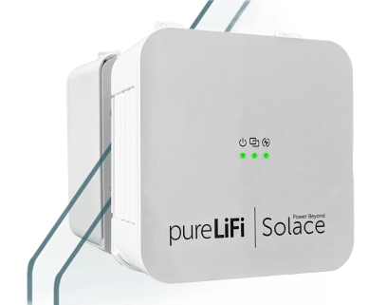

Current Deployments & Companies
Real-World Implementations
Military & Defense
NATO tested Oledcomm's LiFi during NOBLE JUMP exercise in Sardegna for secure tactical communications.
Aviation
Air France and Latcore collaborated with Oledcomm for in-flight Li-Fi internet connectivity demonstration on A321 aircraft.
Aerospace
INSPIRE-SAT 7 nanosatellite launched in 2024 equipped with Oledcomm's LiFi technology for internal communications.
Healthcare
Hospitals implementing Li-Fi in operating rooms and sensitive areas where RF interference must be eliminated.
Leading Li-Fi Companies
pureLiFi
Founded by Prof. Harald Haas, offers LiFi-XC and LiFi Cube products. Launched LINXC Bridge system in 2025 for telecom companies.
Oledcomm
French company specializing in LiFiMAX products. Partnered with French Ministry of Armed Forces for tactical deployments.
Signify (formerly Philips Lighting)
Commercial Trulifi solutions for offices and industrial spaces. Focusing on smart lighting integrated with Li-Fi.
Other Key Players
VLNComm, Panasonic, General Electric, and Lightbee developing Li-Fi solutions for various markets.

Slide 14


Future Outlook
Future Prospects
Market Growth: Expected to reach USD 32.14 billion by 2033, growing at a CAGR of 62.90% from 2025-2033
Standardization: IEEE 802.11bb standard approved, enabling wider industry adoption
Research Focus: Improved range, ambient light resistance, miniaturization of receivers
Integration: Li-Fi/Wi-Fi hybrid networks likely to emerge for complementary coverage
Major Companies Driving Adoption:
pureLiFi
Signify (Philips)
Oledcomm
VLNComm

Slide 15

Conclusion
Key Conclusions
Speed Revolution: Li-Fi offers unprecedented data rates up to 224 Gbps, potentially transforming connectivity
Security Enhancement: Containment of light signals provides inherently more secure networks
Specialized Applications: Optimal for RF-sensitive environments, high-security settings, and dense deployments
Complementary Technology: Will coexist with Wi-Fi rather than replace it, addressing specific use cases
The Future is Bright
Li-Fi represents a promising solution to bandwidth limitations, security concerns, and electromagnetic interference challenges faced by conventional wireless technologies.
"As we illuminate our spaces, we'll also be connecting our devices."

Slide 16

Any Questions ?
August 7, 2025
Made with Genspark

Slide 17
Thank You
August 7, 2025
Made with Genspark

